Slide 1
Team Phantom Menaces
Maciej Stech (G00428784)
Role: Scrum Master
Seán O Doherty(G00292097)
Role: Dev OPs
Enoch Olaoye (G00430326)
Role: Tester
Laoi Rafferty (G00436395)
Role: Project Manager

Slide 2

Project description
Solution4forU is a mobile-first utility price comparison app designed to help users quickly compare essential household services as well as tracking the expenses.
The app connects to provider APIs to retrieve live pricing data for:
⚡ Electricity
🔥 Gas
🌐 Broadband
📱 Mobile Plans

Slide 3
Elevator pitch
The product is for renters and home owners who have a difficult time tracking and maintaining their bills and / or subscriptions. Solution4U is a monetary management application that tracks your expenses and shows you competitive offers from other companies. Unlike other apps / websites like bonkers.ie we offer a tracker as well as an advisor all in one single application

Slide 4
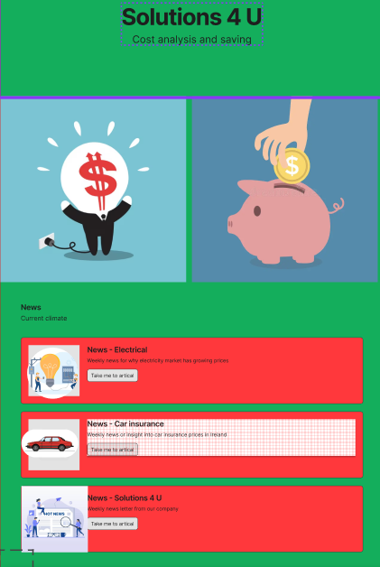
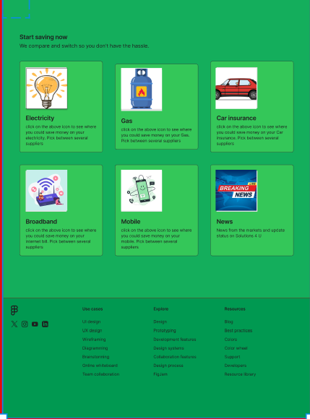
Product Box

Slide 5
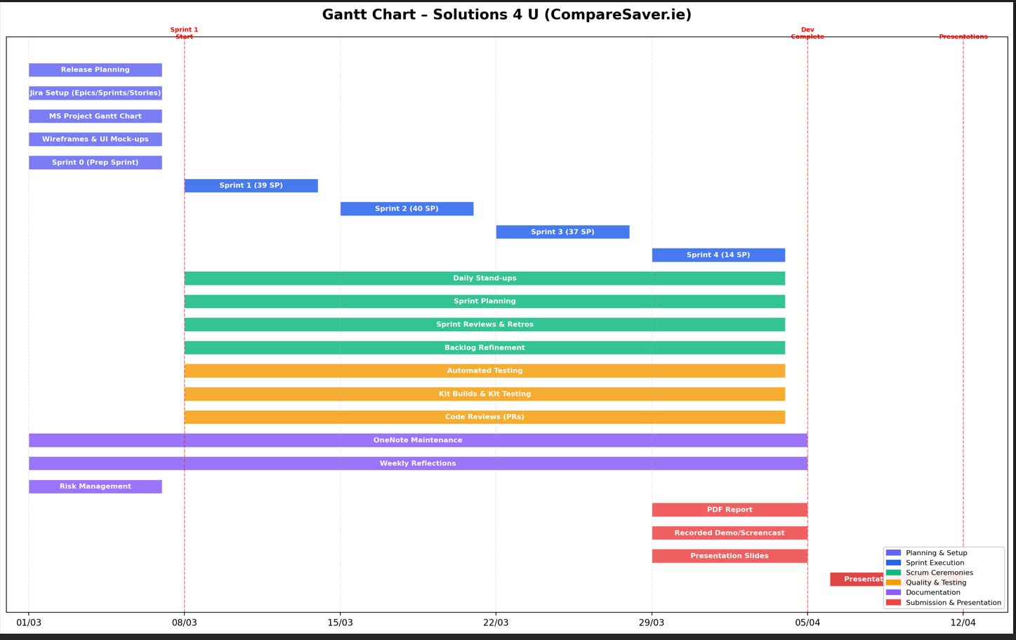
High-level Gantt chart

Slide 6
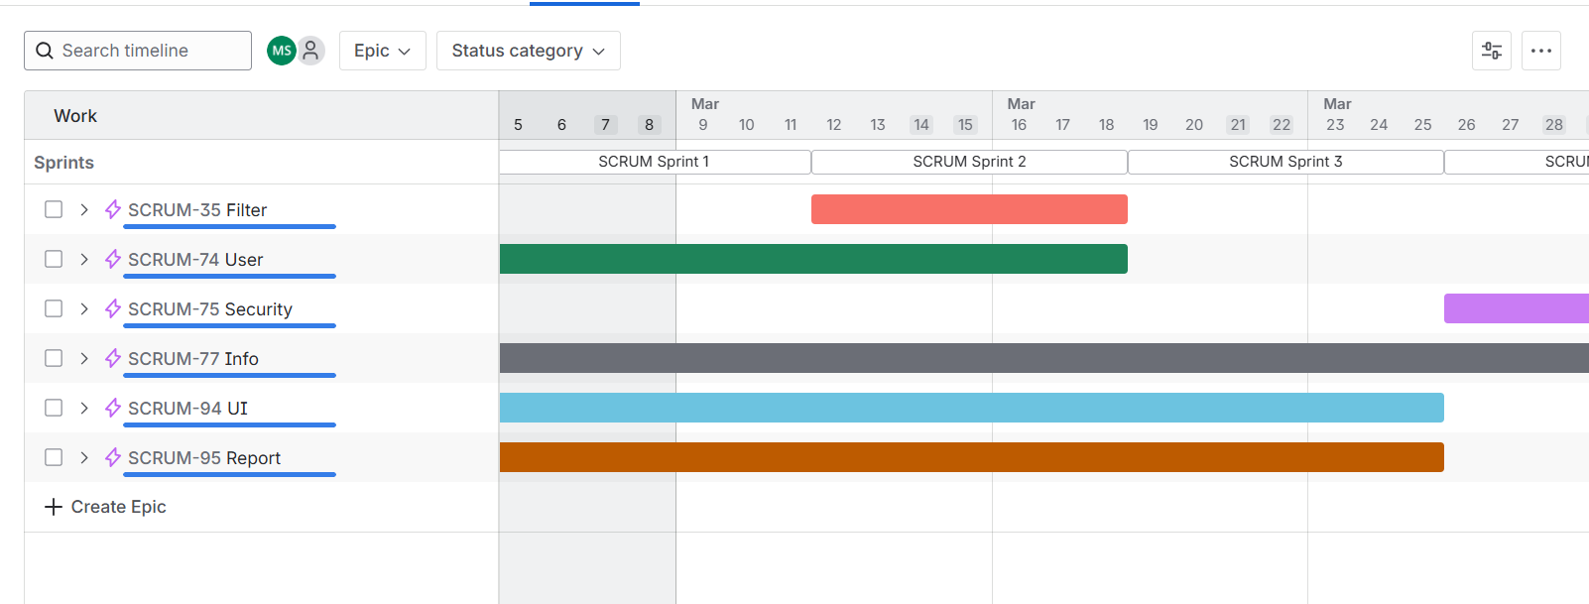
Product roadmap

Slide 7
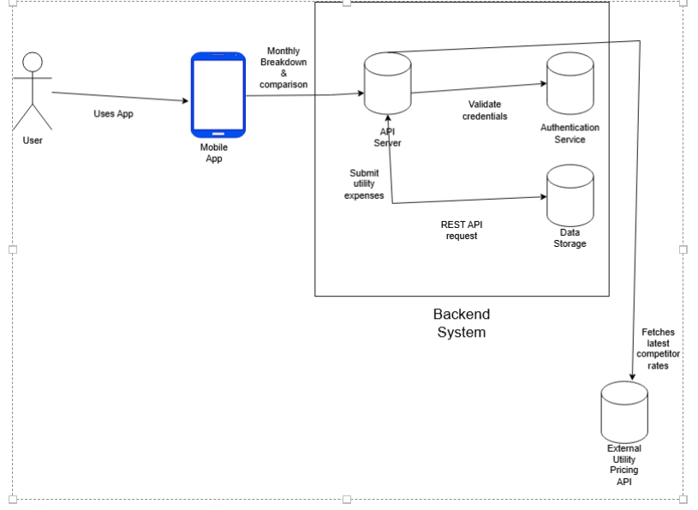
System architecture overview
Front End - Java
Back End - Java / Kotlin
Database - SQL
IDE - VS Code

Slide 8
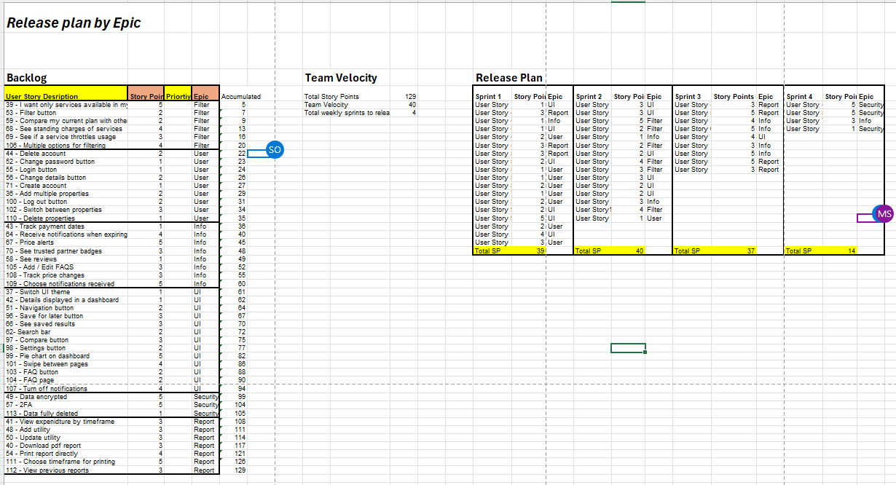
Release Plan and Burndown Chart

Slide 9
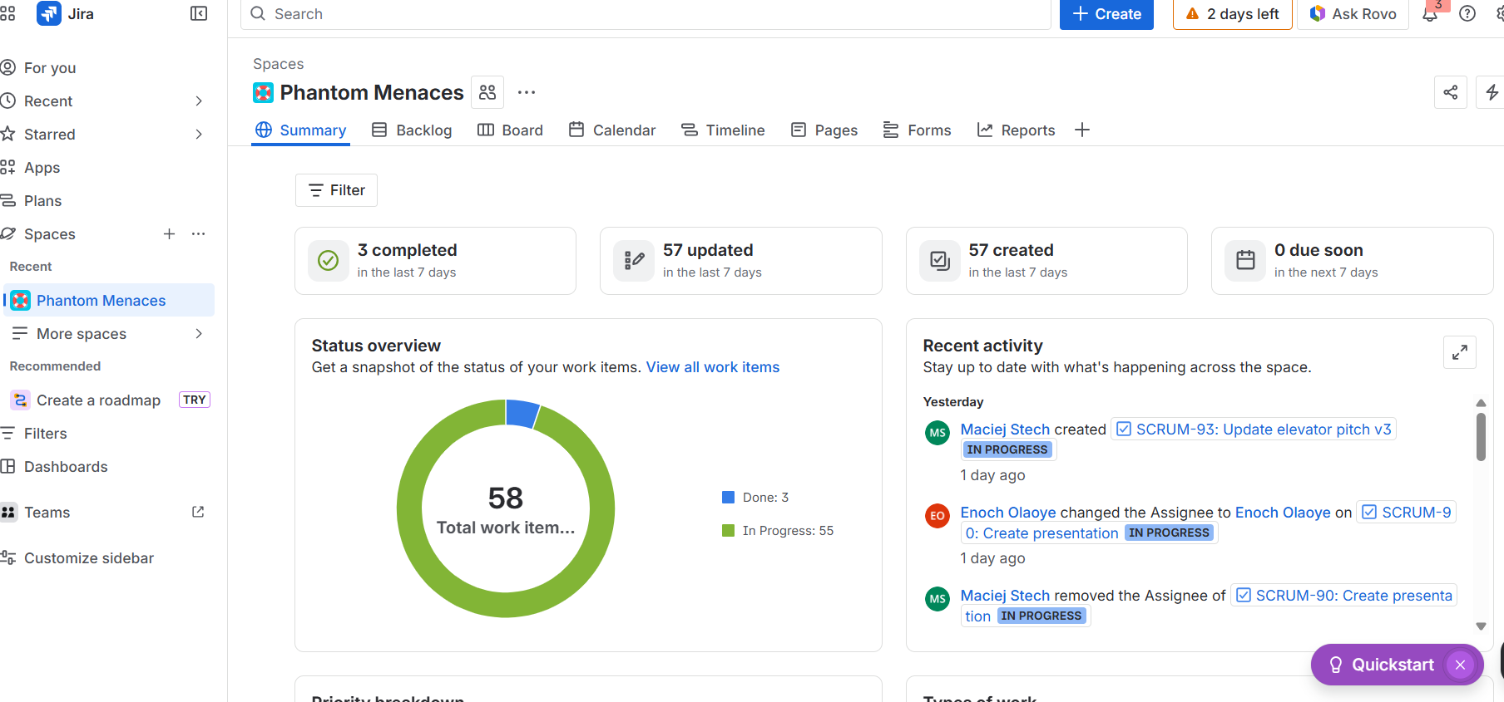
Jira Demonstration
https://atu-team-fb5irdzm.atlassian.net/jira/software/projects/SCRUM/boards/1/backlog

